Slide 1
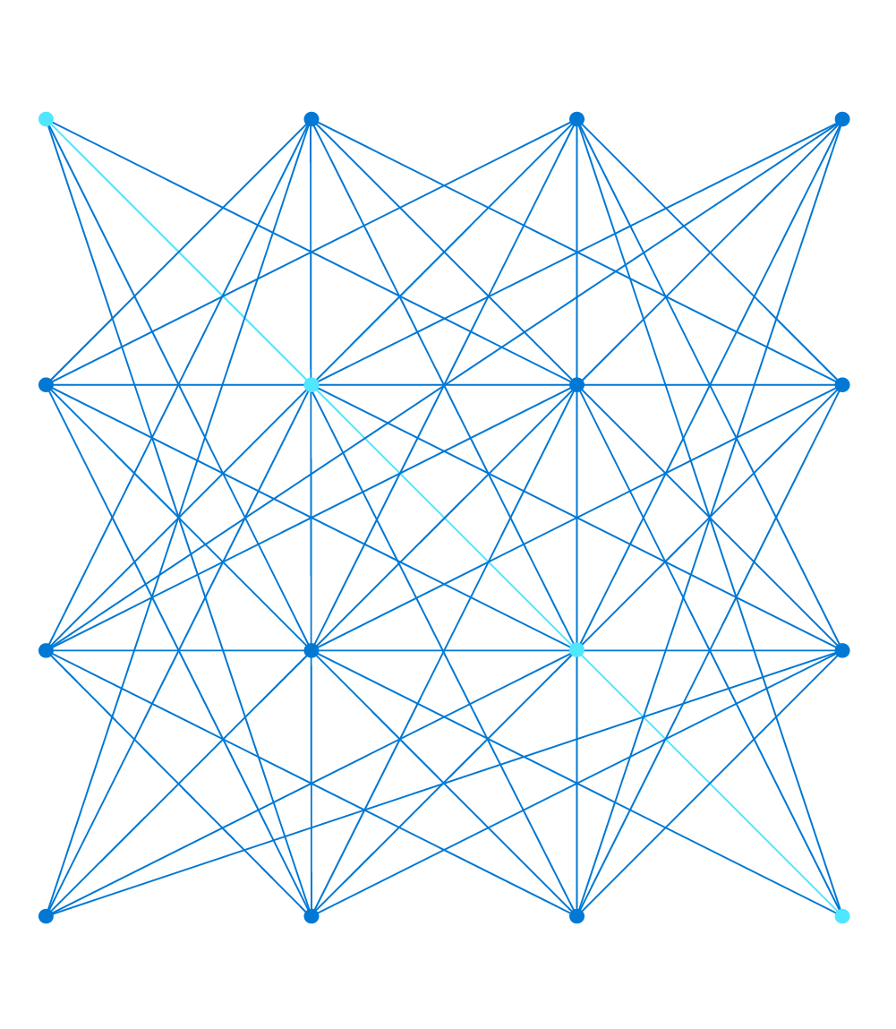

Terraform
Damien Aicheh
Cloud Solution Architect
damienaicheh@microsoft.com

Slide 2
Format of this training
Training for Terraform beginners
Alternate between theory and practice
6 blocs of 4 hours to focus on Terraform
For the time of the training, you’re blocked from customer and other internal calls
There are no stupid questions so don't hesitate to ask
At the end of this training, you will have a good understanding of the way to start a Terraform project

Slide 3



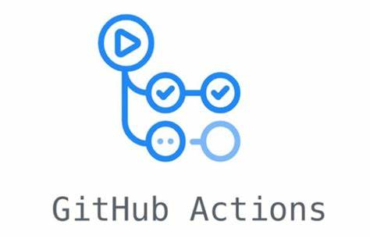
Prerequisites for each participant
An Azure account with contributor rights
Visual Studio Code with Terraform plugin:
https://marketplace.visualstudio.com/items?itemName=hashicorp.terraform
In your local machine:
Terraform
Azure CLI
Docker (optional)
Access to GitHub Actions / Ability to create repositories

Slide 4
HashiCorp Terraform

Slide 5
HashiCorp
HashiCorp is based in San Francisco and was founded in 2012
HashiCorp provides a suite of open-source tools intended to support development and deployment of large-scale service-oriented software installations.
Each tool is aimed at specific stages in the life cycle of a software application, with a focus on automation

Slide 6
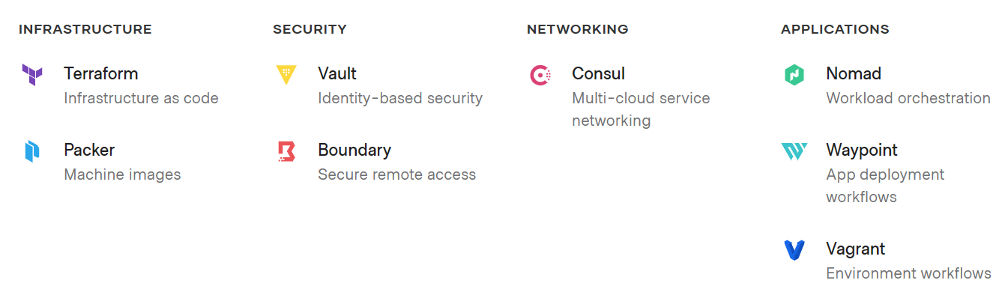
HashiCorp current products

Slide 7
Terraform
HashiCorp Terraform enables you to safely and predictably create, change, and improve infrastructure.
Codifies APIs into declarative configuration files that can be shared among team members, treated as code, edited, reviewed, and versioned.
Abstraction layer over common public/private cloud provisioning/automation languages
Declarative Config Files are written in HCL (HashiCorp Configuration Language)
Single binary without complex installation
Cross platform, can be run on Windows, Linux, or MacOS
Written in Go with plugin-oriented architecture

Slide 8



Terraform
What Terraform is NOT write once, deploy anywhere
Providers are the libraries for the different vendors
Providers have different settings
Terraform enables deployment in Azure, AWS and Google using different providers, configured with different settings
Terraform use the same langage but not the same resource:
Azure: Storage Account
AWS: S3
GCP: Cloud Storage

Slide 9
Terraform
Terraform enables management of multi cloud environments using a single toolset and syntax
Broad community, very responsive
Frequent releases: approximately every two weeks
Extensible
Open source / no vendor lock-in
Microsoft is heavily investing in making most Azure services supported
Microsoft add Terraform support on there products, like Azure Dev Cli (azd)

Slide 10
Terraform: Caveats
Very new, or advanced Azure functionality may not be natively available in Terraform Provider
Workarounds do exist: the azurerm_template_deployment resource can be used to wrap a native ARM Template, but this has its own limitations (it doesn’t support resource deletions)
Unencrypted secrets in state file
You have to manage the state of your platform

Slide 11
Hands On Lab!

Slide 12
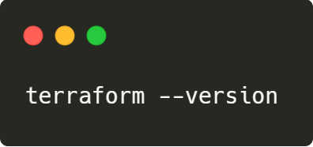
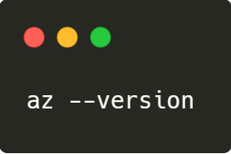
Check your configuration
Just run in your favorite terminal:
For Terraform:
For Azure CLI:

Slide 13
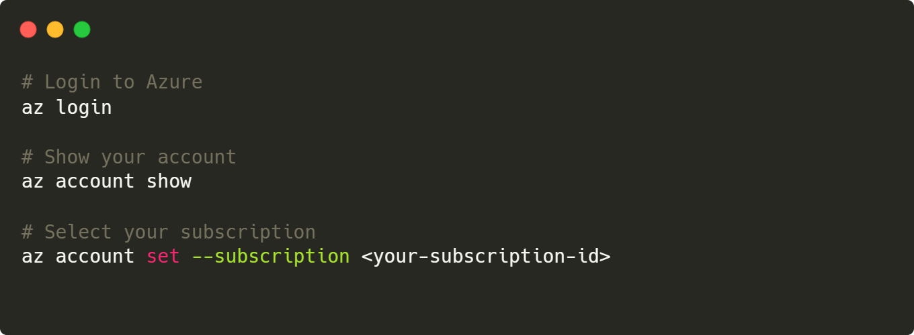
Set up your Azure account

Slide 14
HCL Language

Slide 15
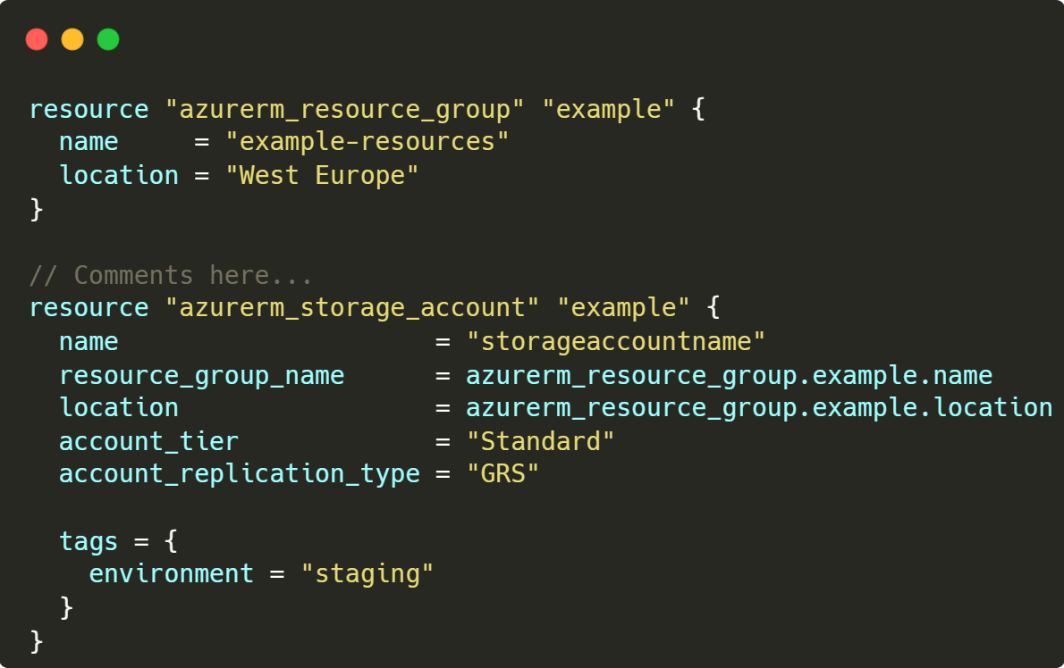
HCL (HashiCorp Configuration Language)
One language and Cross Platform
Human and machine readable
*.TF files, UTF-8 encoded
Blocks containing key/value pairs
HCL is not JSON
Less nesting
Less brackets
Supports inline comments
#, //, /* */
Case sensitive
Naming convention: snack case
Notes:
ARM:
Dependencies must be explicitly defined using nesting, or DependsOn property

Slide 16
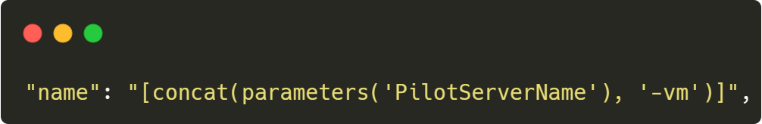
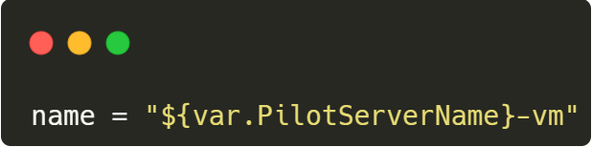
ARM Template vs Terraform HCL
Terraform HCL is about 50-70 % more compact than ARM.
ARM JSON
Terraform HCL

Slide 17
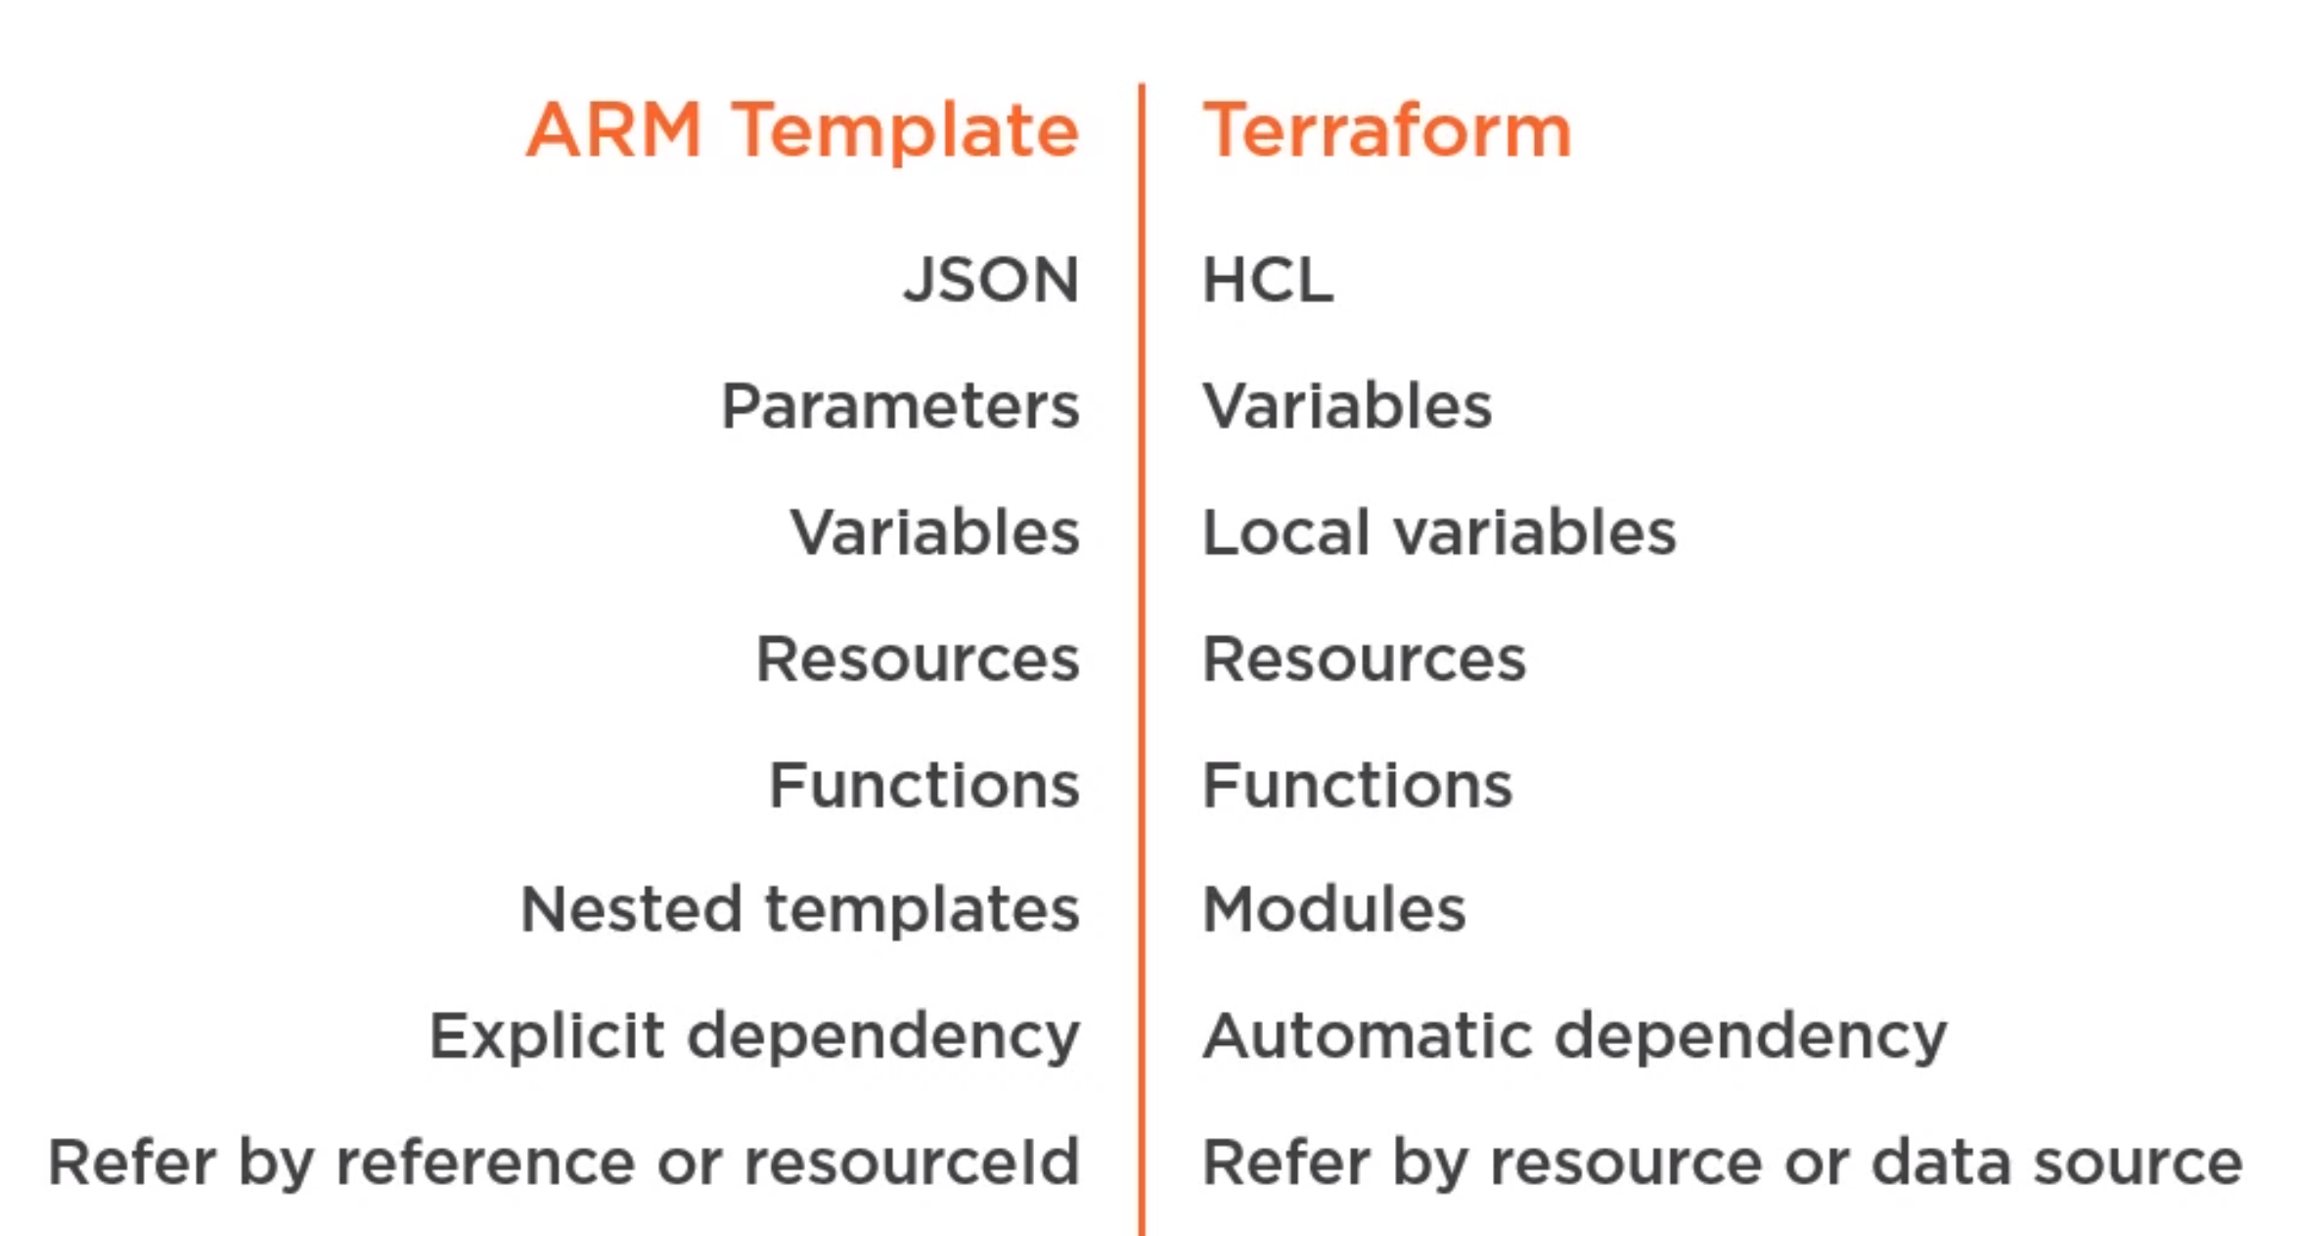
ARM Template vs Terraform HCL

Slide 18
Terraform variables, locals and outputs
 | Variables | Locals | Outputs
What | Parameters | Local variables | Results
Example | Environment name | Resource group name based on combination of variables, operations, prefix and suffix | Resource Identifier, Resource Url
How to reference it? | var.<name> | local.<name> | module.<module name>.<output name>

Slide 19
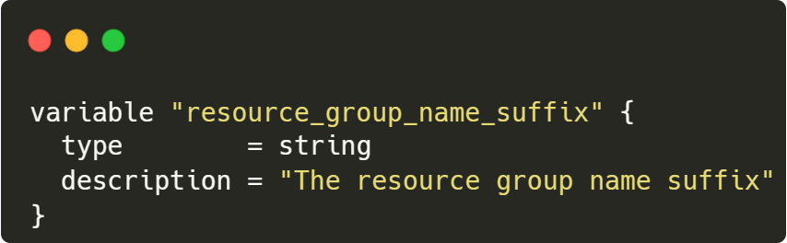
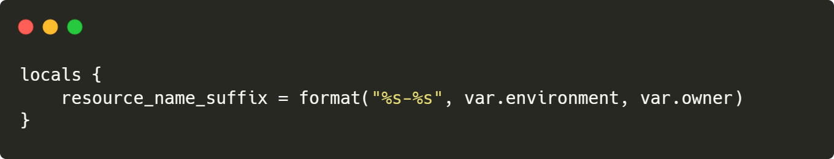
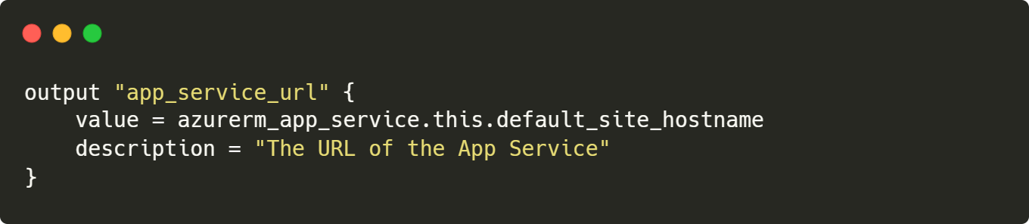
How to declare variables, locals and outputs

Slide 20
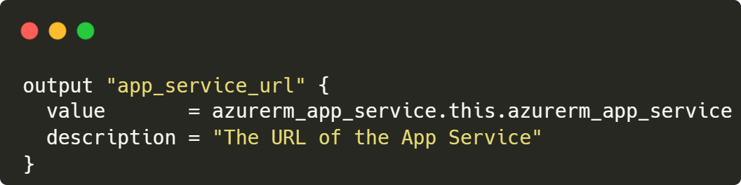
Optional arguments: Description
Always a string

Slide 21
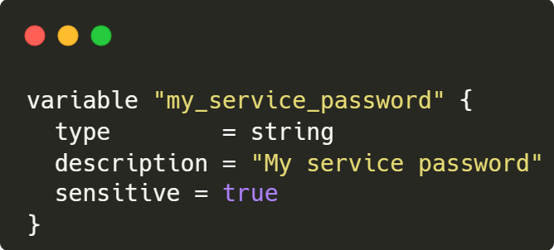

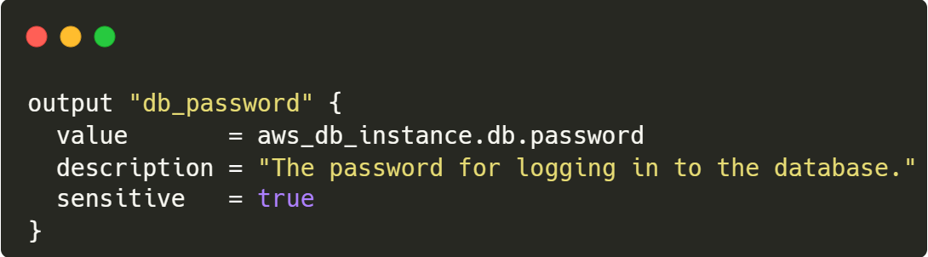
Optional arguments: sensitive
Boolean (true/false)
Suppressing Values in CLI Output
Secrets must be stored in Key Vault directly
Secrets are stored unencrypted in the state

Slide 22
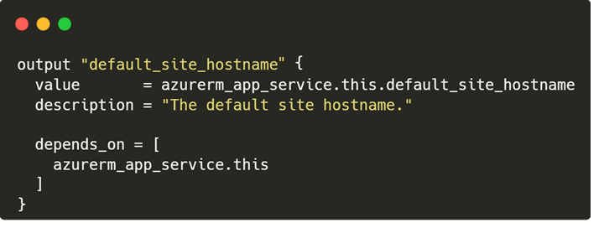
Optional arguments: depends_on
Explicit dependency
Does not exist for variables

Slide 23
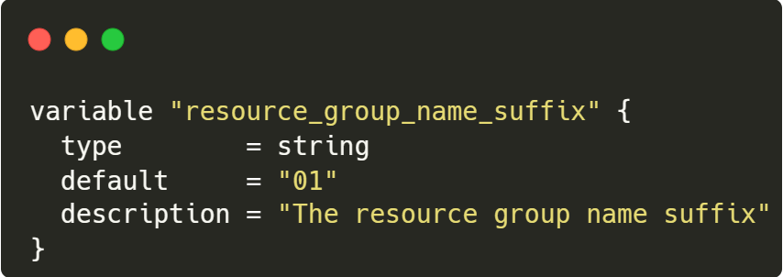
Optional arguments: default
Default value means that the variable become optional
Does not exist for outputs

Slide 24
Optional arguments: type
Types is optional but recommended to restrict the values like:
string
number
bool
list<Type>
set(<Type>)
map(<Type>)
object({<ATTR NAME> = <TYPE>, ... })
tuple([<TYPE>, ...])
Does not exist for outputs

Slide 25
Optional arguments: type
Category | Type | Description | Example: Declare | Example: Access Value
Any | Any | Any type / no constraint |  | var.myVar
Primitive Type | string | Double quoted, with common escape sequences: \n, \t, \\, \“ Multi-line strings „heredoc“ format. | “\“multi\“\nline“ <<EOT multiline heredoc string EOF | var.myVar
 | number | whole number, as well as fractions | 12 3.3475 | var.myVar
 | bool | true / false |  | var.myVar
Complex Types | list(<TYPE>) | sequence of values, 0-based index | ["us-west-1a", "us-west-1c"] | var.myVar[0]
 | set(<TYPE>) | Collection of unique values |  | var.myVar[0]
 | tuple([<TYPE>, ...]) | Similar to list, but each element may have different types | [“us-west-1a“, 12] | var.myVar[0]
 | map(<TYPE>) | group of values identified by named labels | {name = "Mabel", city = “Munich“} | var.myVar.name var.myVar[“name“]
 | object({<ATTR NAME> = <TYPE>, ... }) | Similar to map, but attributes may have different types | {name = "Mabel", age = 52} | var.myVar.name var.myVar[“name“]

Slide 26
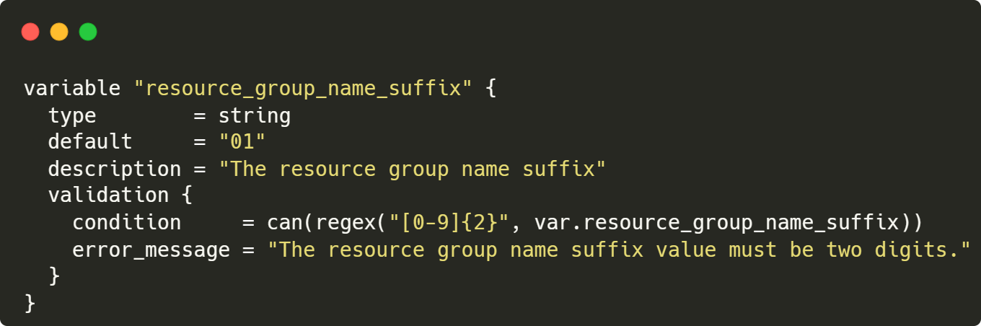
Optional arguments: validation
Advanced validation rules like regex or conditions
Does not exist for outputs

Slide 27
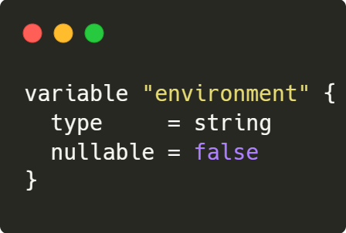
Optional arguments: nullable
Boolean (true/false), whether null is allowed or not for the variable, default is true
Does not exist for outputs

Slide 28
Terraform Expressions
Category | Syntax | Description
Operators | !, - (multiplication by -1) *, /, % +, - (subtraction) >, >=, <, <= ==, != && || | Ordered operators == requires same type / no implicit conversion In general: Terraform is case sensitive => “a“ != “A“ => Also case for function names matters!
Conditional expression | condition ? true_val : false_val e.g. var.a != "" ? var.a : "default-a" | Implicit conversion, if results don‘t have same type => string + number results in string
For expression | [for k, v in var.map : length(k) + length(v)] | Variable for key k is optional. In case of map and object, it contains the key. For list, set and tuple, it contains the index number.
Notes:
https://www.terraform.io/language/expressions/operators
https://www.terraform.io/language/expressions/conditionals
https://www.terraform.io/language/expressions/for
https://www.terraform.io/language/expressions/splat

Slide 29
Terraform Functions
Category | Functions - see official docs for full list
Numeric | Functions with 1 or 2 param: abs, ceil, floor, log, parseint, pow, signum max and min: numeric functions expecting 1..n arguments Syntax: max(1, 3, 4) Or expand list using „…“: max([1, 3, 4]...) sum: collection function, only expecting list: sum([1, 3, 4])
String | chomp, format, formatlist, join, lower, regex, regexall, replace, split, strrev, substr, title, trim, upper
String / Collection | length
Collections | Checks: alltrue, anytrue, contains, Returning collections: chunklist, coalescelist, compact, concat, distinct, flatten, keys, range, reverse, slice, values Returning primitive types: coalesce, index, lookup, Returning maps or objects: merge, transpose, zipmap Returning sets: setintersection, setproduct, setsubstract, setunion
Encoding | base64gzip, csvdecode, jsondecode, jsonencode, textdecodebase64, textencodebase64, urlencode, yamldecode, yamlencode
Date and time | formatdate, timeadd, timestamp
Hash and Crypto | md5, sha256, sha512, rsadecrypt, uuid
Type Conversion | tobool, tolist, tomap, tonumber, toset, tostring, try
Notes:
https://www.terraform.io/language/functions
Numeric
signum determines the sign of a number, returning a number between -1 and 1 to represent the sign.
parseint parses the given string as a representation of an integer in the specified base and returns the resulting number. The base must be between 2 and 62 inclusive.
sum: listed as collection function in official docs
String
chomp removes newline characters at the end of a string.
format produces a string by formatting a number of other values according to a specification string. It is similar to the printf function in C, and other similar functions in other programming languages.
formatlist produces a list of strings by formatting a number of other values according to a specification string.
replace
replace searches a given string for another given substring, and replaces each occurrence with a given replacement string.
If substring is wrapped in forward slashes, it is treated as a regular expression, using the same pattern syntax as regex.
strrev reverses the characters in a string.
title converts the first letter of each word in the given string to uppercase.
trim removes the specified set of characters from the start and end of the given string.
trimprefix removes a word from the start of a string.
trimsuffix removes a word from the end of a string.
trimspace removes all types of whitespace from both the start and the end of a string.
Type Conversion
Try
try evaluates all of its argument expressions in turn and returns the result of the first one that does not produce any errors.
This is a special function that is able to catch errors produced when evaluating its arguments, which is particularly useful when working with complex data structures whose shape is not well-known at implementation time.

Slide 30
Terraform Workflow and commands

Slide 31
Terraform Workflow: init
init
Initializing working directory
Download provider version
Analyzing modules
Backend initialization

Slide 32
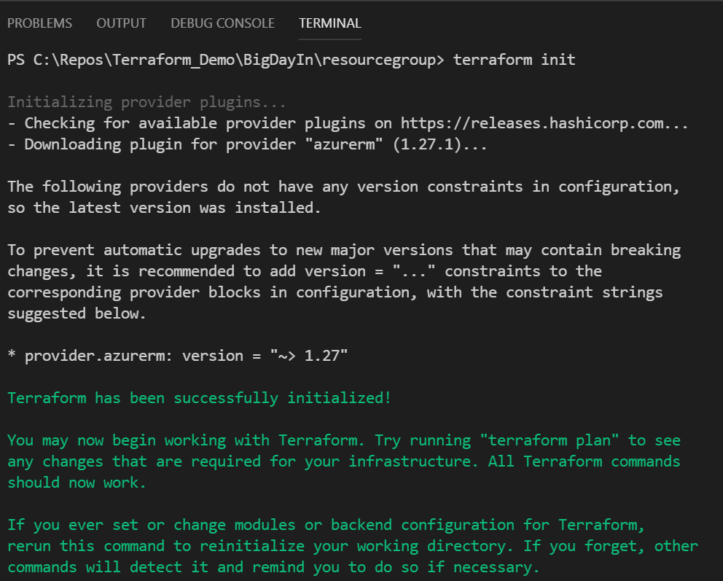
Terraform Workflow: init
Before running terraform init, connect to Azure using az CLI to obtain an authorization token, and select the subscription you wish to deploy to.
Run the init command in the directory that contains the *.tf files to be deployed.
It determines which providers to download based on the .tf files in the current directory.
Provider files are stored within the current directory in a hidden directory “.terraform”
Notes:
https://www.terraform.io/cli/commands/init

Slide 33
Terraform Workflow: plan
init
plan
Initializing working directory
Download provider version
Analyzing modules
Backend initialization
Compares code changes to current state
Creates a list of instruction to migrate the state to the desired changes
Creates a plan file with the list of instruction (no execution)

Slide 34
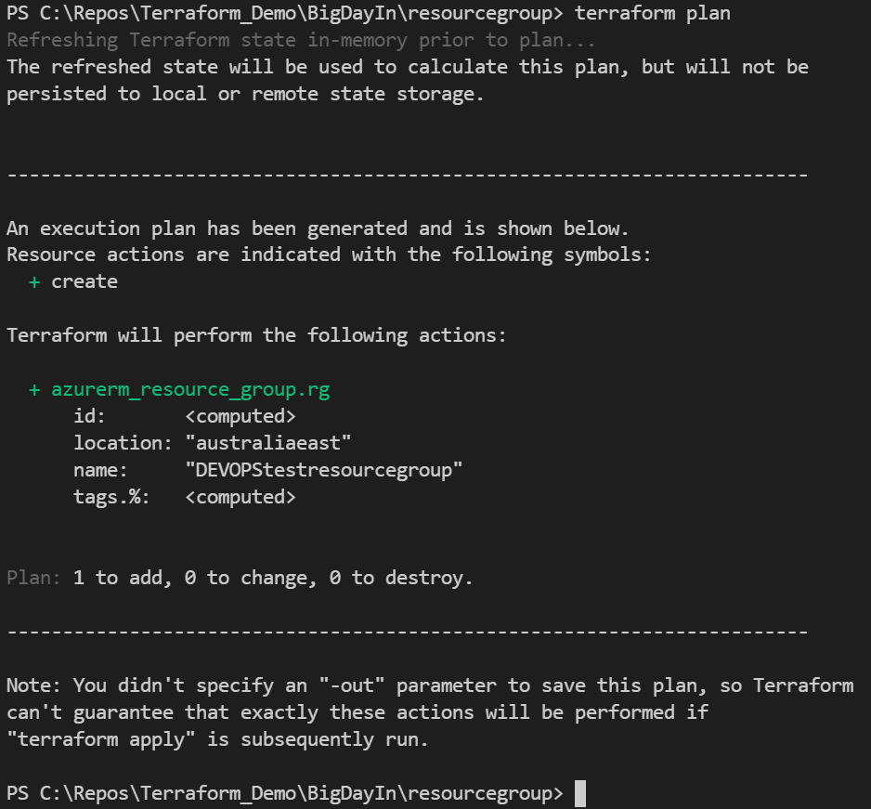
Terraform Workflow: plan
Plan command provide a preview of the actions
It’s an opportunity to sanity check the deployment.
Resource additions will be indicated by a + symbol, and highlighted in green
Resource modifications will be indicated by a ~ symbol and highlighted in orange
Resource deletions will be indicated by a – symbol and highlighted in red
Colours only shown if supported by terminal
Where required, specify the –var and –var-file parameters to pass in variable values to the plan command.
Notes:
https://www.terraform.io/cli/commands/plan

Slide 35
Terraform Workflow: apply
init
plan
apply
Initializing working directory
Download provider version
Analyzing modules
Backend initialization
Compares code changes to current state
Creates a list of instruction to migrate the state to the desired changes
Creates a plan file with the list of instruction (no execution)
Actual infrastructure: Applies the set of instruction created in the plan file

Slide 36
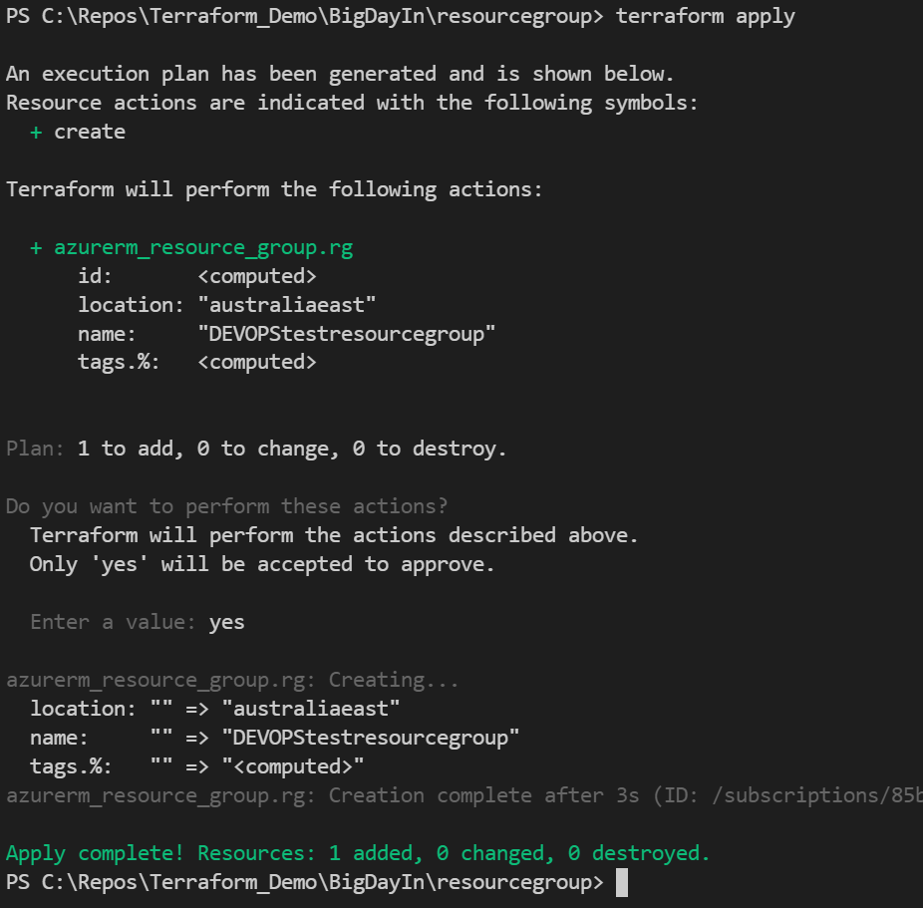
Terraform Workflow: apply
The apply command is used to execute the terraform deployment and add, change and delete resources.
For automated deployments the -auto-approve parameter is used to skip the confirmation step.
Where required, specify the –var and –var-file parameters to pass in variable values to the apply command.
This command can take some time to run for large deployments. Continuous output will be provided to assist in monitoring progress.
Notes:
https://www.terraform.io/cli/commands/apply
If no plan file is specified, terraform apply will create a plan itself!

Slide 37
Terraform Workflow: destroy
init
plan
apply
destroy
Initializing working directory
Download provider version
Analyzing modules
Backend initialization
Compares code changes to current state
Creates a list of instruction to migrate the state to the desired changes
Creates a plan file with the list of instruction (no execution)
Actual infrastructure: Applies the set of instruction created in the plan file
Actual infrastructure: Remove all configured resources

Slide 38
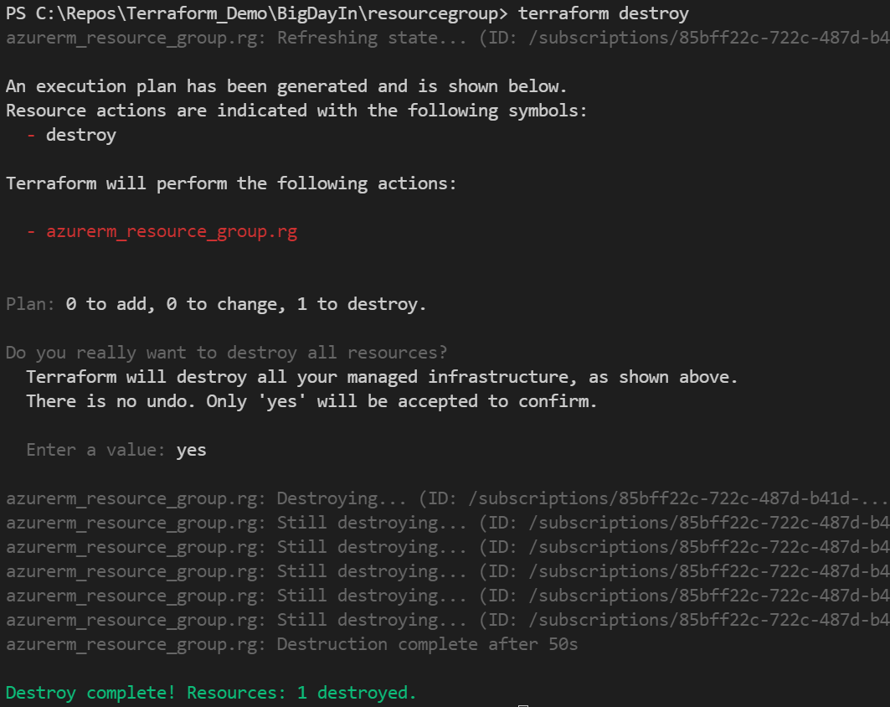
Terraform Workflow: destroy
The destroy command will remove all resources specified in the deployment .tf files.
When executed, a plan is printed to show the resources that will be destroyed, and you are prompted for confirmation.
For automated deployments the -auto-approve parameter is used to skip the confirmation step.
Where required, specify the –var and –var-file parameters to pass in variable values to the destroy command.
This command can take some time to run for large deployments. Continuous output will be provided to assist in monitoring progress.
Notes:
https://www.terraform.io/cli/commands/destroy

Slide 39
Terraform commands
Command | Description
terraform init | Initialize the context of the project (providers, modules, backends…)
terraform fmt -recursive | Format the tf files in a standard manner
terraform validate | Validate the syntax of the tf files BUT there is no guarantee that the deployment will succeed
terraform plan | Define the potential creation, updates, deletion based on the current tfstate of the architecture
terraform apply | Apply the changes based on the plan.out if provided
terraform destroy | Destroy all the resources defined in the tfstate

Slide 40
Hands On Lab!

Slide 41
HCL: HashiCorp Configuration Language
Play with variable file provided (main.tf)
Use terraform init to initialize the project
To test the code just run:
terraform plan
terraform apply
The instructions are on the next slide

Slide 42
HCL: HashiCorp Configuration Language
Output the application_name with only the 3 first characters
Output the letters array in one single string with dashes to separate each letter
Create a variable string called domain and when you output it make sure it’s lowercase
Return the node count in a dedicated output
Return the node size in a dedicated output
Output a resource group name which will be a concatenation of the official abbreviation “rg” and the application name and domain formatted previously. Dashes must separate each part.
E.g. rg-<application name>-<domain>

Slide 43
Resources & Data Sources

Slide 44
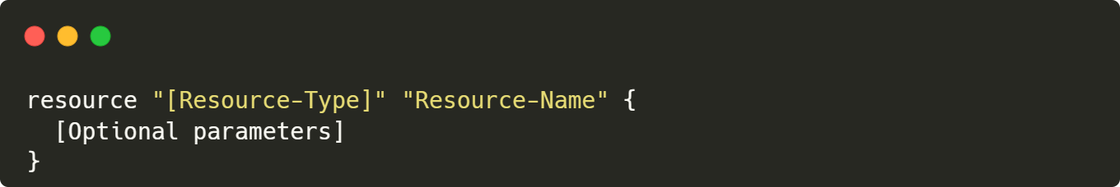
Resources
Most important element in the Terraform language.
Each resource block describes one or more infrastructure objects
Syntax:
https://www.terraform.io/language/resources

Slide 45
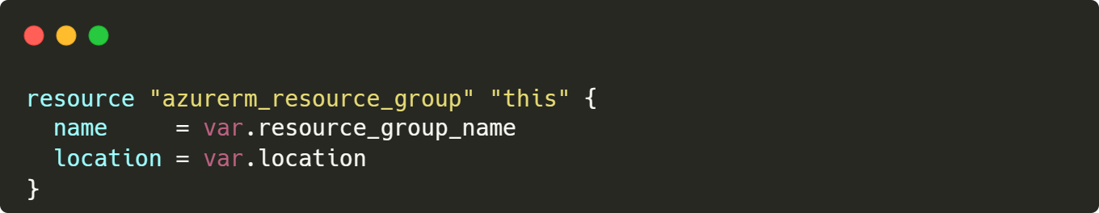
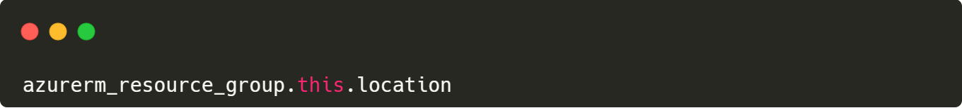
Resources
Syntax example for an Azure resource group:
Syntax to access to values:

Slide 46
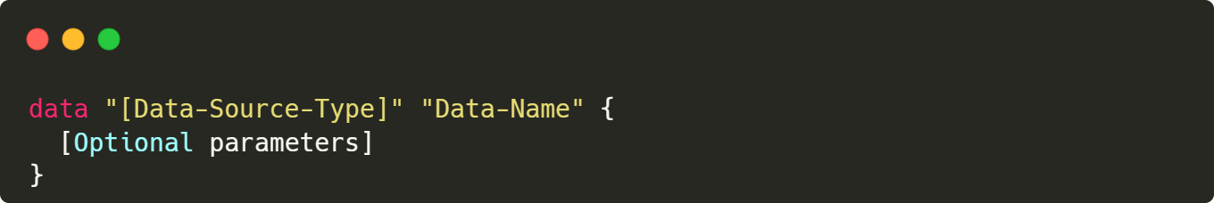
Data Sources
Use information defined outside of Terraform, for instance Azure
Use information defined by another separate Terraform configuration (state)
Syntax:
https://www.terraform.io/language/data-sources

Slide 47
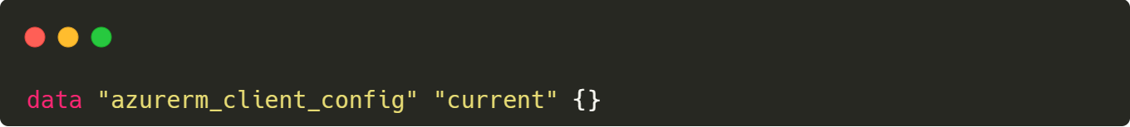
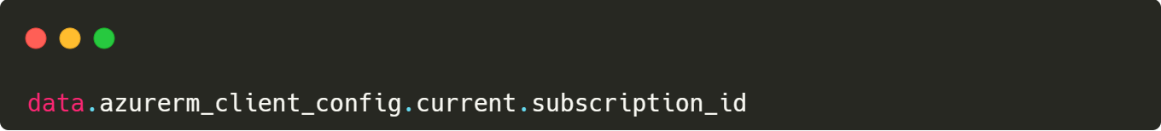
Data Sources
Syntax example for data source to declare the access the configuration of the AzureRM provider:
Syntax to access the values, for instance the subscription id:

Slide 48
Terraform State

Slide 49
Terraform State: Overview
Terraform stores the state about your managed infrastructure and configuration in a file
The state is used to map real world resources to the configuration
Terraform uses this state to create plans and make changes to your infrastructure
Sensitive information is stored unencrypted within state
terraform show can be used to display managed resources in the state

Slide 50
Terraform State: Local vs. Remote
The state is stored by default in a local file named terraform.tfstate
It’s configured using backend block in the provider resource
Local State – for non-prod tests only
Remote State – Should be stored remotely (e.g. blob) to enable security and collaboration
Before each deployment, Terraform must be able to obtain a lock on the state file.
Once the deployment is complete, the lock is released.
Azure Storage Accounts support file locking which prevents multiple people from simultaneously executing a Terraform deployment, security, version control and disaster recovery capabilities for your state files.

Slide 51


Terraform State: Remote
Terraform has his own cloud: Terraform Cloud Remote State Management
Azure Storage Accounts support file locking which prevents multiple people from simultaneously executing a Terraform deployment, security, version control and disaster recovery capabilities for your state files.
If a state is lock, you will have to connect to Azure Storage Account and click “Break lease”

Slide 52
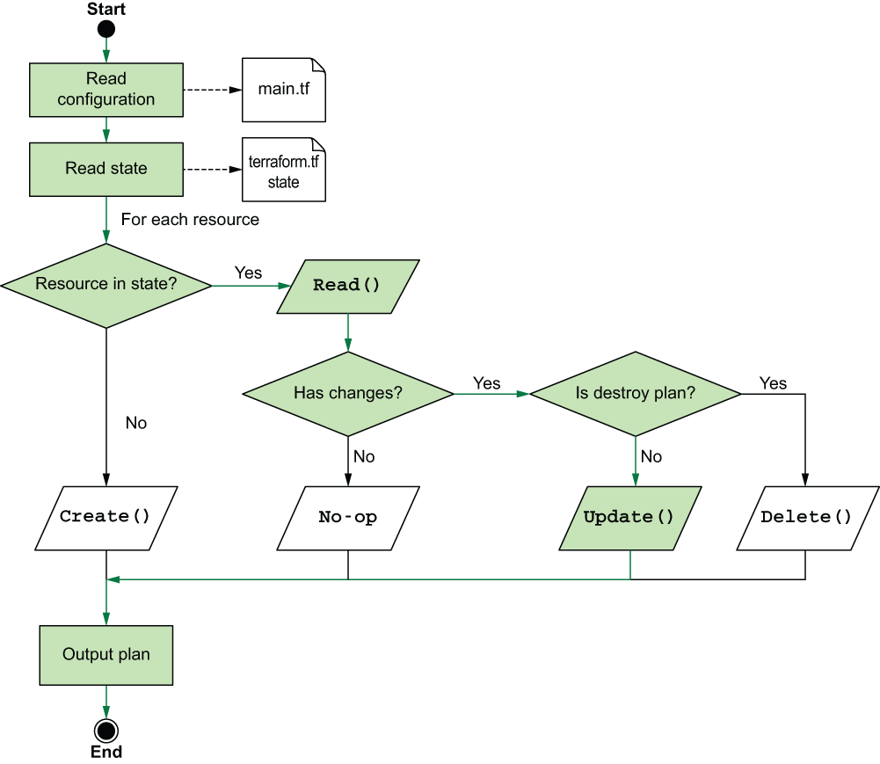
How the plan is generated

Slide 53
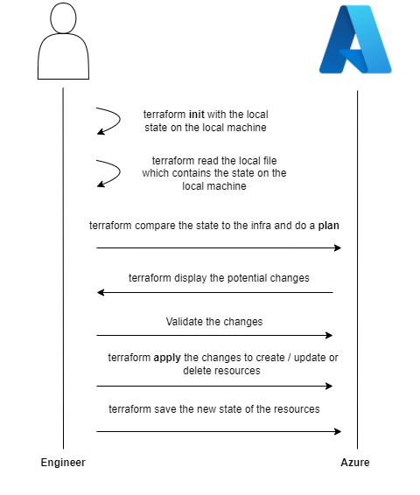
Terraform State: Locally

Slide 54
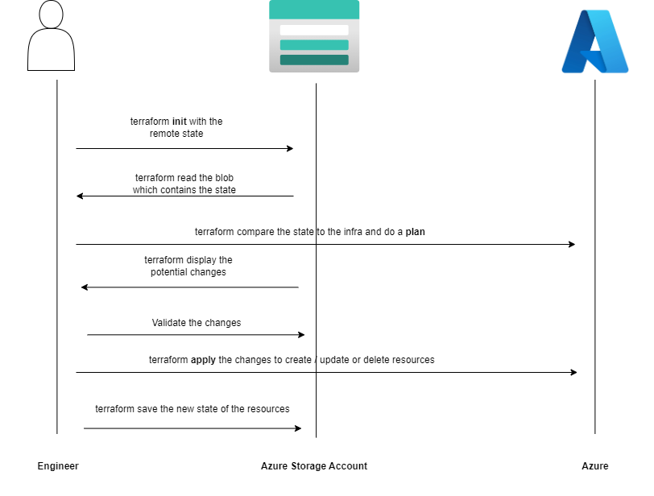
Terraform State: Remotely

Slide 55
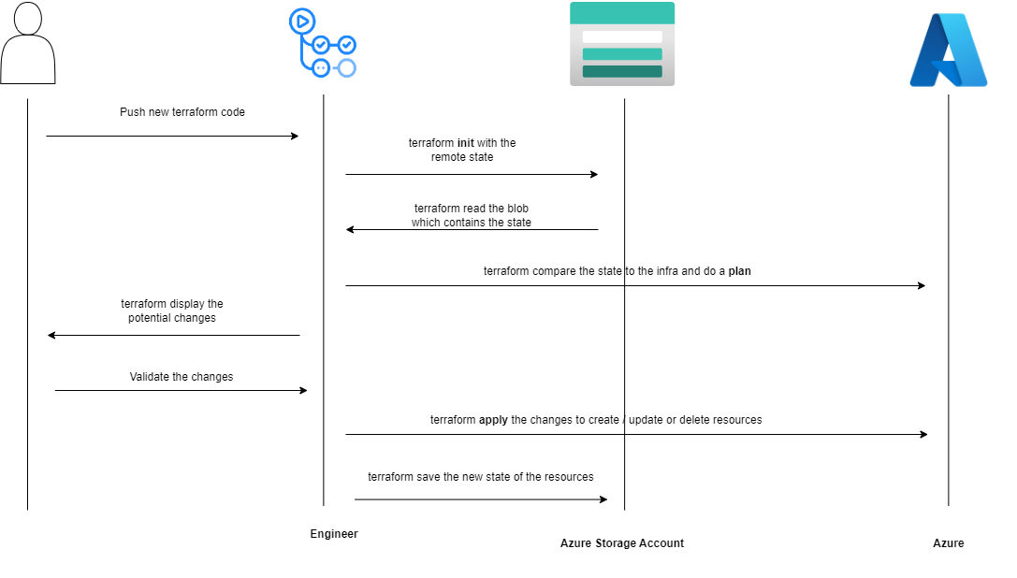
Terraform State: DevOps

Slide 56
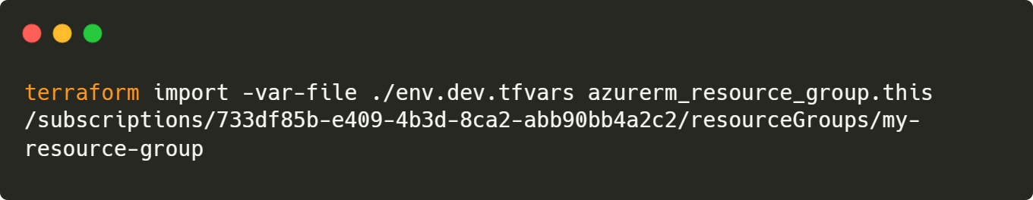
Don‘t touch the User Interface
Keep the User Interface in ReadOnly mode
If you modify a resource managed by Terraform you can end up with a broken state
You will have to import each resource manually to the state, which can be really long and complex
terraform import can be used to explicitly map actual resources to configurations.

Slide 57
Providers

Slide 58
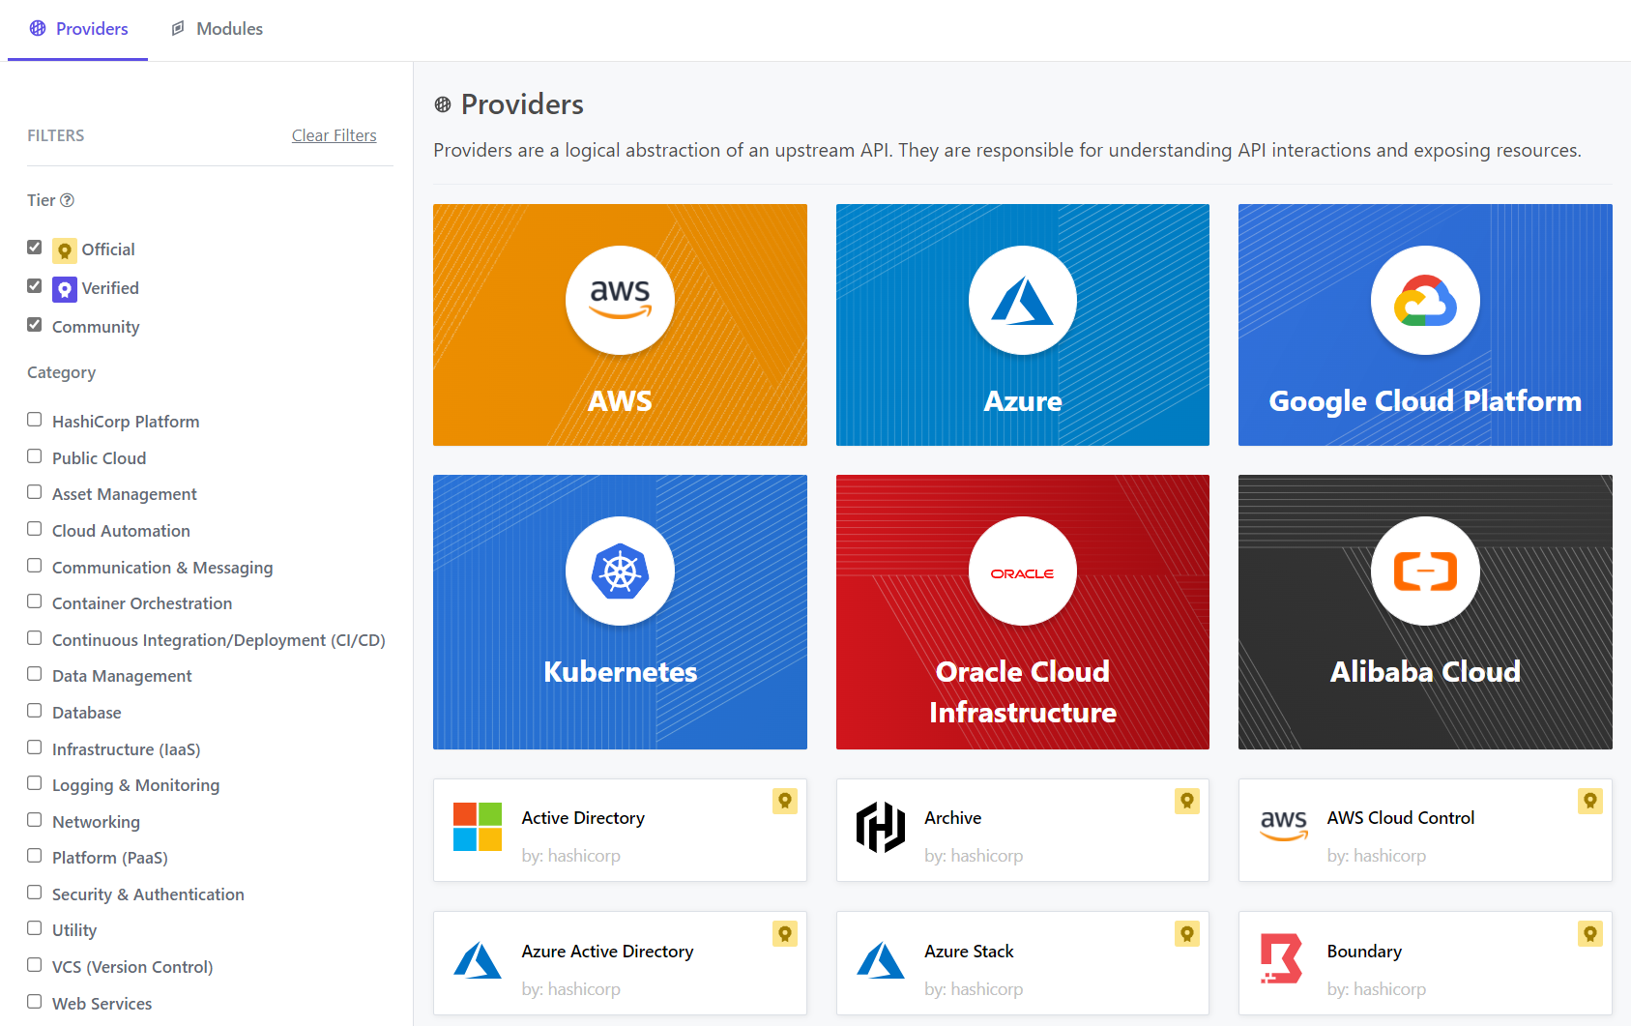
Terraform Provider: Available ones
https://registry.terraform.io/browse/providers

Slide 59
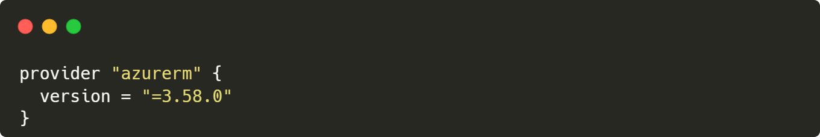
Terraform Providers
The terraform core program requires at least one provider to build anything.
You can manually configure which version(s) of a provider you would like to use.
If you leave this option out, Terraform will default to the latest available version of the provider.

Slide 60
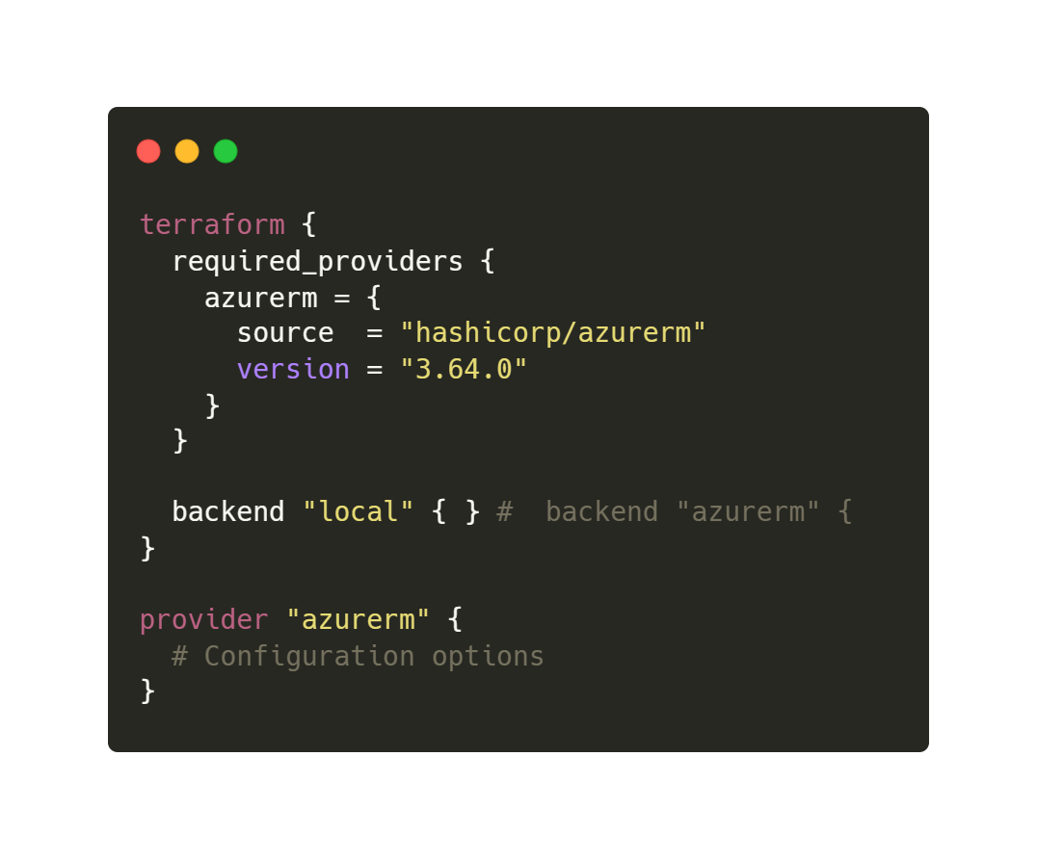
Configure azurerm provider

Slide 61
Authentication with AzureRm

Slide 62
With Service Principal Name (SPN)
Use a user account for development purpose
Use a Service Principal Name (SPN) or Az CLI for deployment purpose
The SPN should have Contributor role
https://learn.microsoft.com/en-us/azure/developer/terraform/authenticate-to-azure?tabs=bash

Slide 63
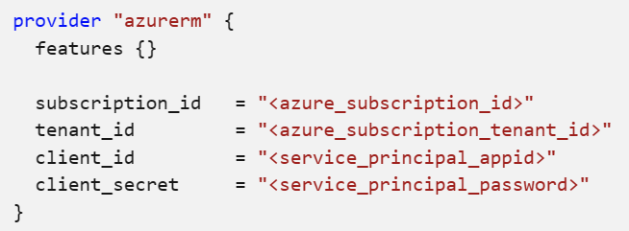
Service Principal Name directly in the code
You can connect Terraform to Azure directly in the code using the provider
SPN credentials in your code is a bad practice
You will probably forget to remove them before pushing the code
This is a security issue
NOT RECOMMANDED

Slide 64
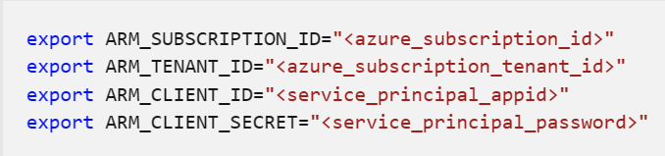
Service Principal Name with environment variable
You can connect Terraform to Azure using environment variables
SPN credentials will be only on your machine
Your code doesn’t have any credentials
Credential lifecycle is a problem with SPN, you need to manage it
https://learn.microsoft.com/en-us/azure/developer/terraform/authenticate-to-azure?tabs=bash

Slide 65
With Az CLI
You can connect Terraform to Azure using Az CLI directly:
Use it for development purpose only

Slide 66
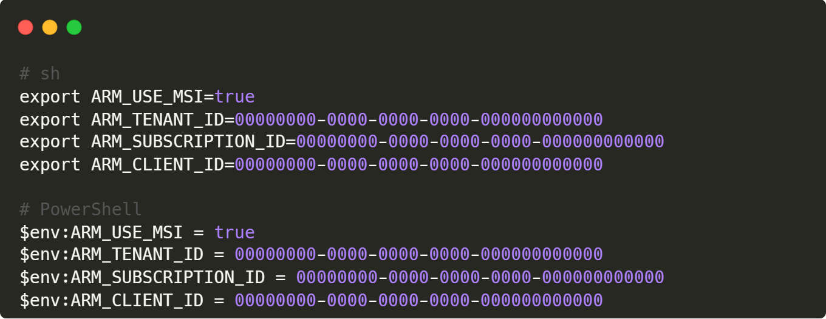
With Managed Identity
Use managed identity declared in Azure Active Directory
The token to authenticate to Azure is managed automatically by Azure Active Directory. You don’t need to monitor the end of life of your token

Slide 67
With Open ID Connect (OIDC)
Azure manage the credentials for you
Generate credentials with short lifetime
Avoid managing manually a Service Principal Name (SPN)
Just need to:
Create an App Registration
Create federated credentials to give access to the repository

Slide 68
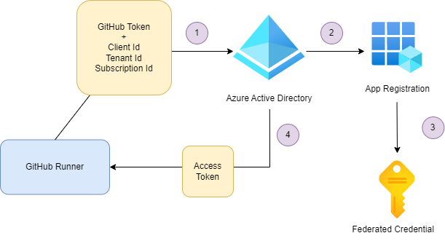
OIDC: How it works?
1) GitHub Runner asks with a GitHub token and an Azure AD identity for an AAD token. Then token contains issuer, audience and subject.
2) Based on the token AAD search the associated identity in the App Registration
3) The App Registration has the federated credential for this repository
4) AAD return an access token, so the GitHub Runner can modify Azure Resources

Slide 69
Hands On Lab!

Slide 70
Connect to Azure Rm
Create a new folder called digital_infra_state
Create a provider.tf file and use use Azure Rm https://registry.terraform.io/providers/hashicorp/azurerm/latest/docs
Use the latest version of Azure Rm
Use local state
Run terraform init to validate that everything is correctly initialized

Slide 71
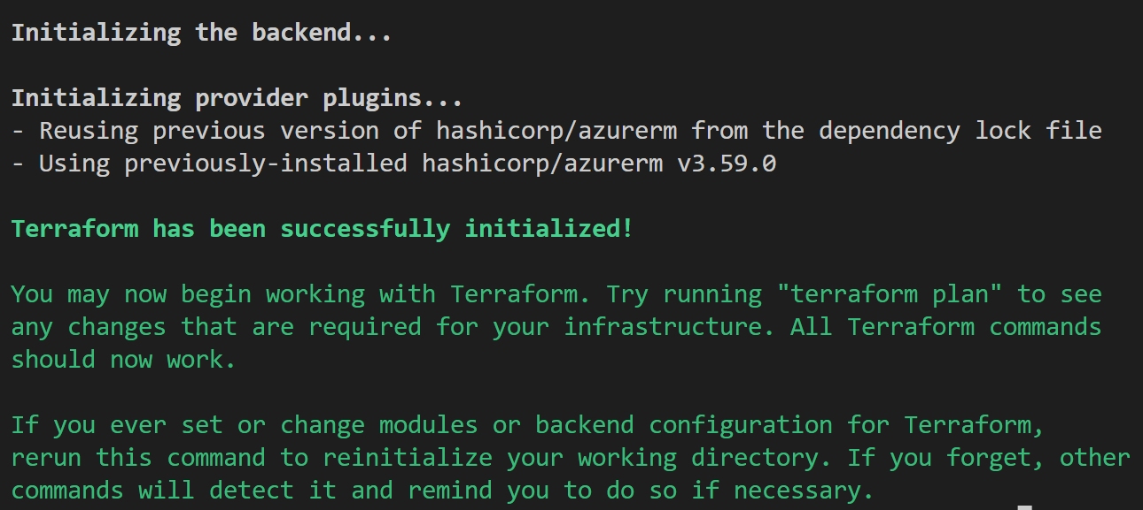
Connect to Azure Rm

Slide 72
Documentation usage: Overview

Slide 73
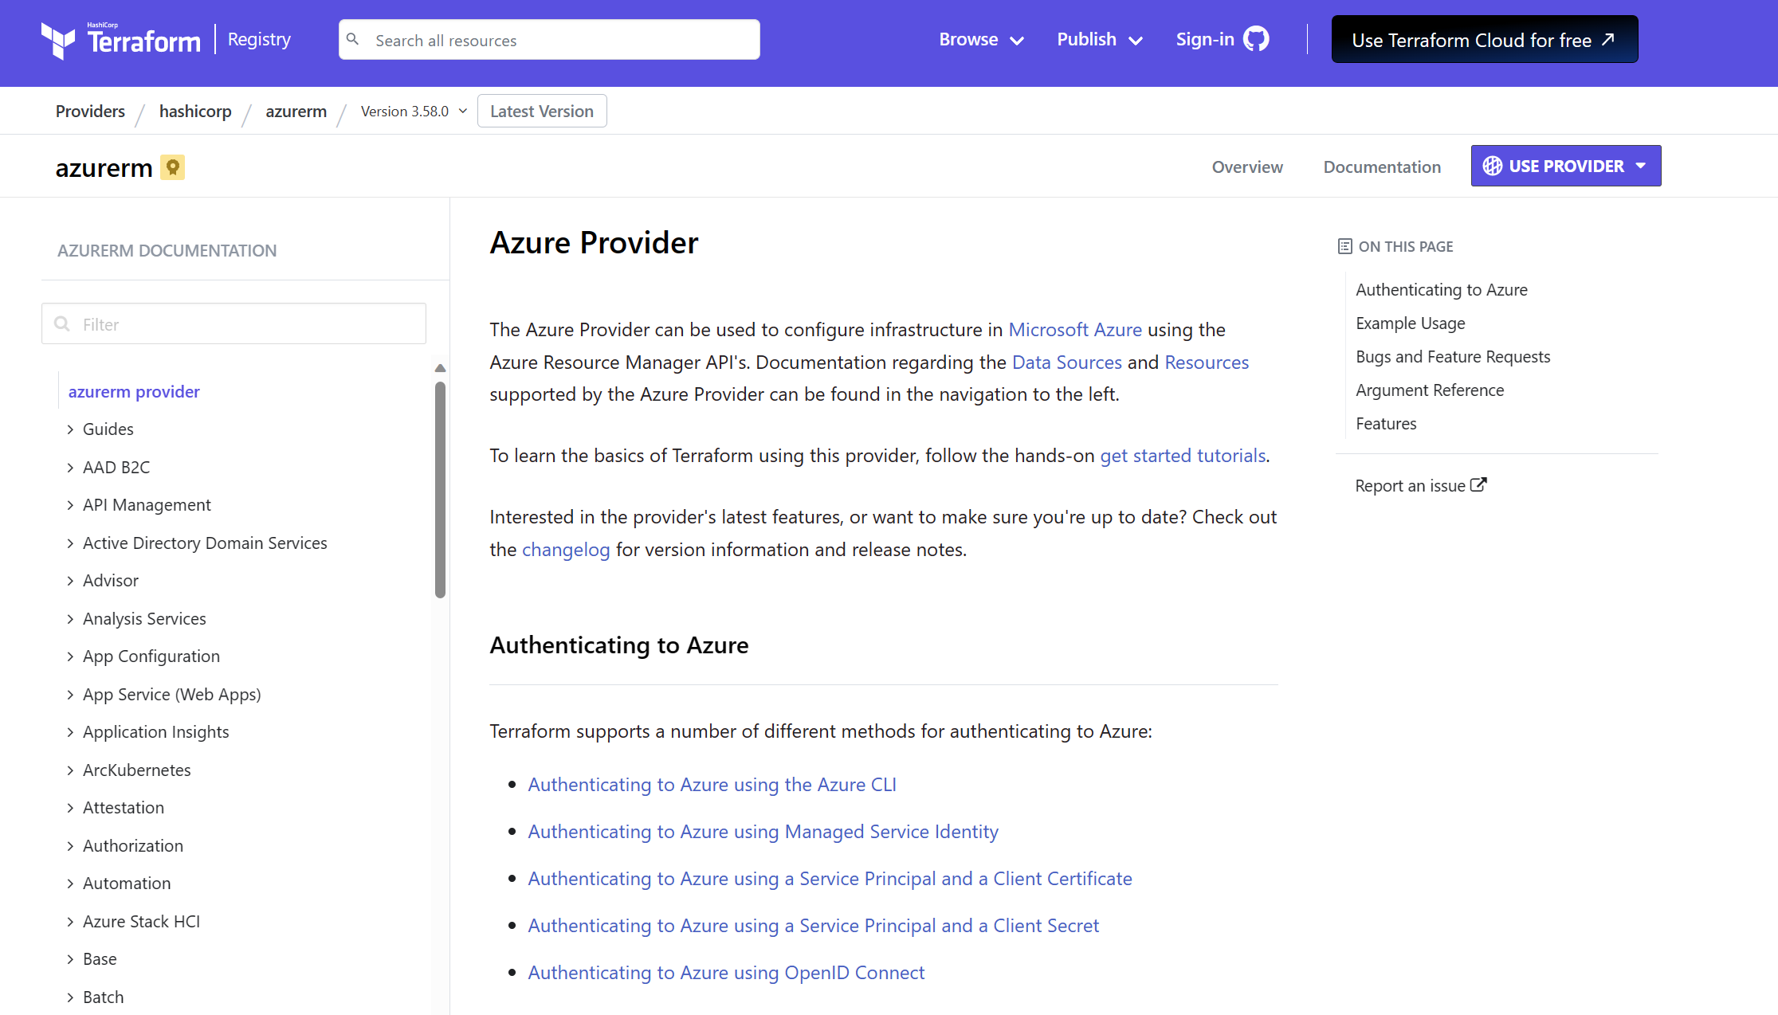
Documentation
Really good documentation
The search bar can be a bit capricious
Use your favorite search engine to find the resource. For instance, type: Resource group Terraform
https://registry.terraform.io/providers/hashicorp/azurerm/latest/docs

Slide 74
Resource sections
Always cut into several parts:
Basic examples to copy-paste
Argument References which are the available properties of the resource
Attributes References which are the available outputs of the resource
Timeouts properties that can be optionally specified
Import a resource to the current state

Slide 75
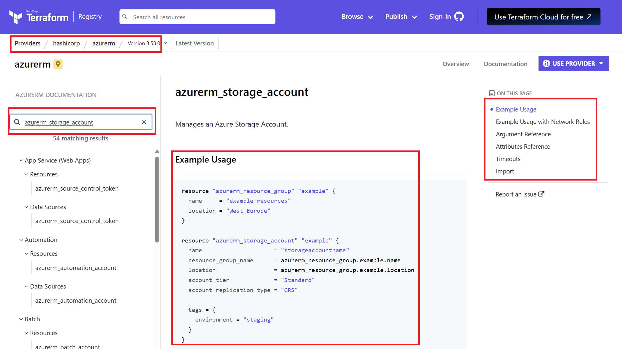
Example

Slide 76
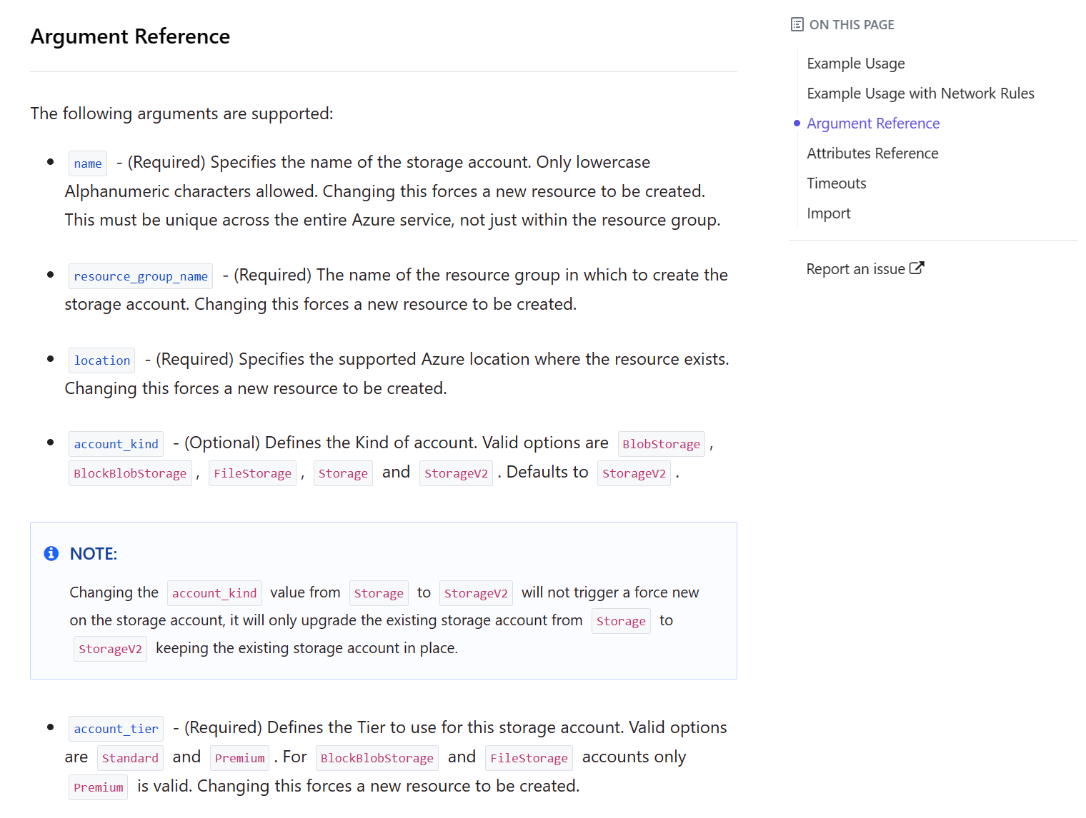
Arguments

Slide 77
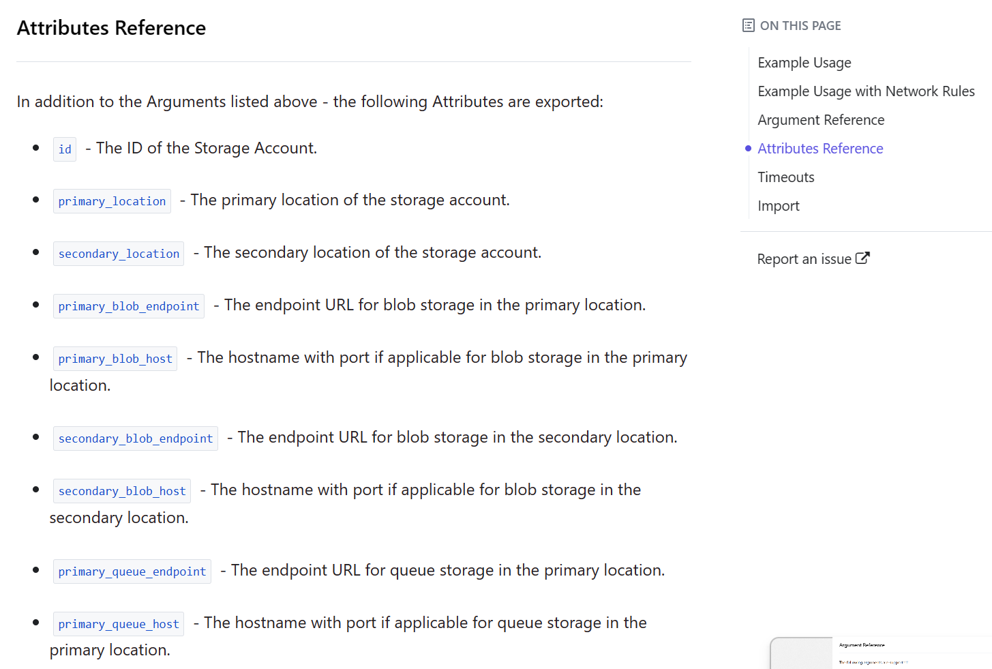
Attributes

Slide 78
Hands On Lab!

Slide 79
Create a resource group with terraform local state
Back to your digital_infra_state folder
Create a variable.tf file to define :
An environment which accept only “dev”, “stag”, “prod” with “dev” as default value
A domain name with default value to “state”
A location with a default value set to “westeurope”
A resource suffix with a default value
Create a locals.tf file to define two resource suffix which are a concatenation of:
The environment
The first 2 letters of the location in lowercase
The first 3 letters of the domain in lowercase
The resource suffix
The resource suffixes should be in this format:
With dashes (kebabcase): <env>-<domain>-<location>-<resource-suffix>
Without dashes (lowercase): <env><domain><location><resource-suffix>

Slide 80
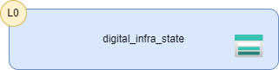
Create a resource group with terraform local state
Create a rg.tf file to define your resource group. Naming convension is: rg-<your-resource-suffix-kebabcase>
Create an sto.tf file to define a basic storage account:
The naming convention is st<your-resource-suffix-lowercase>
Account tier: Standard
Account replication type: LRS
Inside the Storage Account create one private container called “states”
Add tags “Domain” and “Environment” to all your resources.
Use local state
Deploy to Azure

Slide 81
Backend definition

Slide 82
Backend configuration
The backend configuration for Azure Rm is a Storage Account
The Storage Account contains a container with a blob which is the tfstate
Which came first, the chicken or the egg?

Slide 83
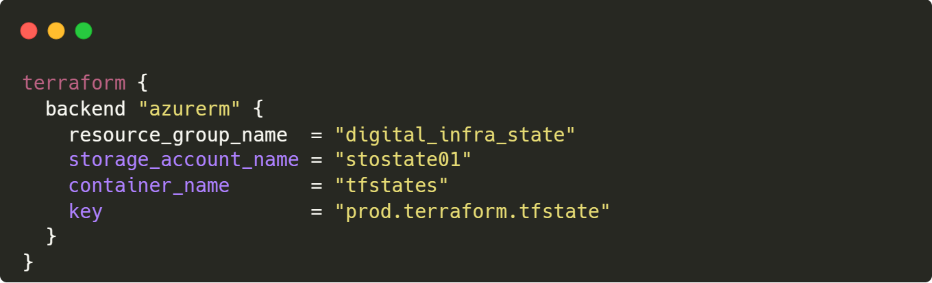
Connect to the Azure Rm backend in code
Useful for testing purpose BUT:
Avoid using this approach because your code must be agnostic to the targeted environment
NOT RECOMMANDED

Slide 84
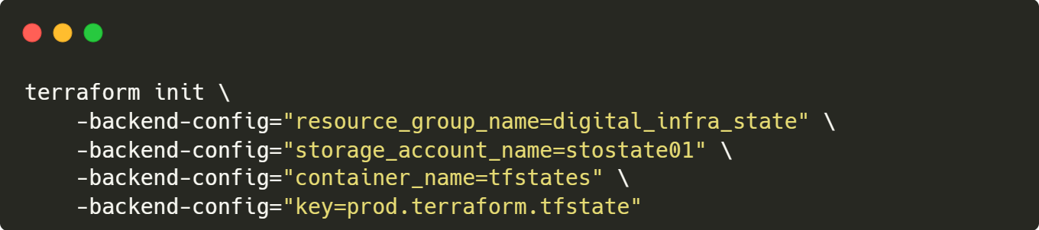
Connect to the Azure Rm backend with backend config
Use the –backend-config option to pass the Azure Rm settings
This can be done for CI / CD
Use environment variables
BEST PRACTICE

Slide 85
Several ways to use environment variables

Slide 86

Pass variables to terraform commands
Pass -var options on the command line

Slide 87


Pass variables to terraform commands
Pass a file as options with -var-file
.tfvars list all variables to set for the deployment

Slide 88

Automatic load of variable files if present
Terraform also automatically loads a number of variable definitions files if they are present:
Files named exactly terraform.tfvars or terraform.tfvars.json.
Any files with names ending in .auto.tfvars or .auto.tfvars.json.

Slide 89

Other ways to pass variables
Environment variables (“TF_VAR_[variable]”, e.g. “TF_VAR_rg_id” for “rg_id”)
Default Config - default value in variables.tf
User manual entry - if not specified, prompt the user for entry

Slide 90
Order of precedence of variables
Once you have some variables defined, you can set and override them in different ways.
Level of precedence for each method (1=highest, 7=lowest):
-var and -var-file options on the command line
Any *.auto.tfvars or *.auto.tfvars.json files, processed in lexical order of their filenames.
The terraform.tfvars.json file, if present.
The terraform.tfvars file, if present.
Environment variables (“TF_VAR_[variable]”, e.g. “TF_VAR_rg_id” for “rg_id”)
Default Config - default value in variables.tf
User manual entry - if not specified, prompt the user for entry

Slide 91
Hands On Lab!

Slide 92
Create a Vnet and Subnet
Create a new folder called digital_infra_network
Based on the same model of the previous lab:
Create a variable.tf
Create a locals.tf
Create a provider.tf
Create an rg.tf for a new resource group
The domain will be the “network”, so find a diminutive to it
Use remote state and store it inside the Storage Account containers “states” created in the previous lab in this path: network/terraform.state

Slide 93
Create a Vnet and Subnet
Create a vnet.tf file to define a VNet with an address range of: 10.0.0.0/16
Create a subnets.tf file to define 2 subnets:
PaasSubnet: 10.0.0.0/24
AppServiceSubnet: 10.0.1.0/28 with a delegation to “Microsoft.Web/serverFarms“ and and action to “Microsoft.Network/virtualNetworks/subnets/action“
Expose the VNet and Subnet Ids in an outputs.tf file
Create a folder called env-vars for your environment variables and one folder for the dev environment. Create an env.tfvars file inside the dev folder to specify the values for the IP ranges for the VNet and the Subnets.
Deploy only the dev environment

Slide 94
Meta-Arguments

Slide 95


Meta-Arguments: depends_on
Explicitly specifying a dependency
Necessary when a resource or module relies on some other resource's behavior but doesn't access to any of that resource's data in its arguments.

Slide 96

Meta-Arguments: lifecycle
Control lifecycle of a resource using arguments within lifecycle block:
create_before_destroy: bool, default false, if destroy is required, it is done after creating the new resource
prevent_destroy: bool, default false, plans resulting in a destroy will fail
ignore_changes: List of feature names (string), to be ignored, if different
Common scenarios to ignore later changes of initial values
default secrets in key vault
login of a sql server
app settings of a web app
Only allows literal elements, no variables / expressions

Slide 97


Meta-Arguments: provider
Select non-default provider to be used
Example: multiple AzureRm provider for different subscriptions
Notes:
https://www.terraform.io/language/meta-arguments/resource-provider

Slide 98

Meta-Arguments: count
Enables creation of 0..n similar objects
Count cannot be used simultaneously with meta-argument for_each.
Usage example:
Zero-Based index number: count.index
Individual instance: <TYPE>.<NAME>[<INDEX>] or module.<NAME>[<INDEX>]
In the example below Count = 0 means skip creation
Notes:
https://www.terraform.io/language/meta-arguments/count

Slide 99

Meta-Arguments: for_each
Enables creation of 0..n similar objects
for_each cannot be used simultaneously with meta-argument count
Use for_each instead of count for loop, this will avoid to have terraform state lost
Usage example:
Current object: each.key (map key / set member), each.value (map value)
Individual instance: <TYPE>.<NAME>[<KEY>] or module.<NAME>[<KEY>]
Notes:
https://www.terraform.io/language/meta-arguments/for_each

Slide 100
Use for_each for the loops
Use for_each instead of count for looping over a list of element.
This will allow terraform to keep tracking existing resources and not recreating them
Notes:
https://www.terraform.io/language/meta-arguments/for_each

Slide 101
Hands On Lab!

Slide 102
Create an App Service
Create a new folder called prj1_infra_app
Based on the same model of the previous lab:
Create a variable.tf
Create a locals.tf
Create a provider.tf
Create an rg.tf for a new resource group
The domain will be the “prj1” and add a new variable for the application name and call it whatever you want but limit the characters to 3.
Use remote state and store it inside the Storage Account containers “states” created in the previous lab in this path: prj1/<application name>/terraform.state

Slide 103


Create an App Service
The goal of this lab is to consume the state network state and activate the VNet integration and private endpoint for the App Service.

Slide 104
Create an App Service
Create an app.tf and define:
An App Service Plan with Basic SKU
An App Service for Linux
Create a data.tf file and use the terraform_remote_state resource to connect to the network state with the correct credential methodology:
https://developer.hashicorp.com/terraform/language/settings/backends/azurerm
In your locals.tf get the subnet ids for the app service and paas subnets.
In the app.tf use the azurerm_app_service_virtual_network_swift_connection resource to connect the app service to the app service subnet:
https://registry.terraform.io/providers/hashicorp/azurerm/latest/docs/resources/app_service_virtual_network_swift_connection

Slide 105
Create an App Service
Create a pe.tf file to define the private endpoint
https://registry.terraform.io/providers/hashicorp/azurerm/latest/docs/resources/private_endpoint
The subnet Id should be the Paas Subnet id
For the private service connection, you just have to define:
A name
The private connection resource id, which is the id of your App Service
Sub resources name array should contains only “sites”
Set the manual connection boolean to false.

Slide 106

Create an App Service
If you succeed you should in the Networking section of your App Service these features On:

Slide 107
Terraform Modules

Slide 108
What is a module?
A module is a reusable Terraform template
Allow re-use of certified and standardized infrastructure as code
Can be published at Public Module Registry at https://registry.terraform.io/
Private Repo can be established using GitHub, Bitbucket , S3 buckets,….

Slide 109
Structure of a module
Input
Processing
Output
File: variables.tf
Parameters for module
File: main.tf
Resources and Data blocks
File: outputs.tf
Return results, others may reuse for their processing

Slide 110


Structure of a module
If you follow the convention, you should have this kind of structure:
For more clarity you can split the main.tf file to avoid having one big file with everything defined.
Avoid using data sources inside a module this can create dependency resolution issues for terraform

Slide 111
Module supported sources
What | How
Local Paths | module "alert_group" { source = "./modules/alert_action_group“ }
Terraform Registry | module "consul" { source = "hashicorp/consul/aws" version = "0.1.0" } module "consul" { source = "app.terraform.io/example-corp/k8s-cluster/azurerm" version = "1.1.0" }
GitHub | module "consul" { source = "app.terraform.io/example-corp/k8s-cluster/azurerm" version = "1.1.0" } module "consul" { source = "git@github.com:hashicorp/example.git" }
Generic git repository | module "vpc" { source = "git::https://example.com/vpc.git" } module "storage" { source = "git::ssh://username@example.com/storage.git" }

Slide 112

Pass parameters to a module
Run a terraform init again to install the local module
Example of using a module locally:

Slide 113


Refactoring into a module
Modules are referenced in Terraform state
Refactoring into a modules has an impact on the state
Resource names can be changed or refactored into modules
Define a tf file (moved.tf for instance) when extracting a module during refactoring

Slide 114
Refactoring into a module
Map the old resource name to the new one so terraform can update the state
Use terraform plan to detect the old new naming
If your moved declarations are correct your plan will not have any resources creation or deletion
After this process you can remove your .tf file with all the moved declarations

Slide 115
Hands On Lab!

Slide 116

Migrate the App Service to a module
Back in your prj1_infra_app create a new folder called modules and inside another one called app_service
The goal is to provide a module for app service that manage the VNet integration.
In this module, create a main.tf and put the app.tf file content into it.
Create a variables.tf and an outputs.tf
Move also the pe.tf inside this module

Slide 117
Migrate the App Service to a module
Update all the local properties in the modules
Make the app service plan sku a parameter of your module
Add two outputs to your module: the app service id and app service default hostname
Reference the new module in the app.tf of your prj1_infra_app folder
Make sure to migrate the module without creating or deleting any resource
You may have to use a lifecycle block
Run terraform plan and terraform apply you should have no changes

Slide 118
Provisionners

Slide 119
Provisionners
Provisioners provide access to non-terraform commands and aren’t fully managed by it’s declarative syntax or state.
Examples:
local-exec – run a command locally
remote-exec – run a ssh command on a remote system
file – copy files or directories to remote machine
All provisioners support at least the following arguments:
when = destroy – execute only on destroy
on_failure = fail / continue – default is fail

Slide 120
local-exec
Execute scripts or other programs on the host executing terraform.
Argument | Type | Description
command | string, required | Command to execute Evaluated in a shell, and can use environment variables or Terraform variables
working_dir | string, optional | Working directory where the command will be executed
interpreter | string list, optional | List of interpreter arguments used to execute the command. First argument is the interpreter itself, as relative path to the current working directory or as an absolute path. The remaining arguments are appended prior to the command. Example: ["/bin/bash", "-c", "echo foo“] If interpreter is unspecified, sensible defaults will be chosen based on the system OS
environment | object, optional | Block of key value pairs representing the environment of the executed command.

Slide 121


local-exec
Example: command + interpreter
Example: command + environment

Slide 122
remote-exec
Execute scripts or other programs on a remote system.
Only one of the following arguments allowed:
Argument | Type | Description
inline | string list | List of executed commands in specified order
script | string | Path (relative or absolute) of a local script Local script will be copied to the remote resource and then executed
scripts | string list | List of paths (relative or absolute) of a local script Local scripts will be copied to the remote resource and then executed in specified order

Slide 123

remote-exec
Execute scripts or other programs on the remote system
Examples:
Change some permissions and ownership
Run a script with some environment variables

Slide 124
file
Copy files or directories to a remote system
Argument | Type | Description
source | String | Source file or directory
content | String | Direct content to copy on the destination If destination is a file, the content will be written on that file.
destination | string | Destination path to write to on the remote system Will be evaluated by the remote system, rather than by Terraform itself

Slide 125

file
Copies files or directories onto the remote system
Support for SSH and WinRM connections

Slide 126
Architecture

Slide 127

Layered Deployment
L4
L4
L4
L4
L4
L4
Layer | Components
0 | Bootstrap with init script / DevOps Agent
1 | Security & Compliance
2 | Core Services & Network
3 | Shared Services (Compute, Data Server)
4 | Applications (DB, WebApp, Queue,…)
L3
L2
L1
L0

Slide 128
Layered Deployment
Reduce the scripts to a specific scope
Speed things up
Split responsibilities and permissions between teams.
Each level has its own state

Slide 129

Layered Deployment: Example
Every layer has his own tfstate except the first one
Each layer has outputs exposed to the next layer.
You can add more layers to fit your needs
Example:
L1 expose outputs to L2 / L3…
L3 can consume outputs from L2 / L3

Slide 130

Layered Deployment: Example
Applications layers can be splitted to share resources
Only when business requirements are compatible

Slide 131
Layered Deployments and maturity
Everything Local
Backend State
CI / CD
Layered Deployment
Modules
Bootstrap
Community Approach / Module Registry

Slide 132
DevOps

Slide 133
Branch & deployment strategy
Look at 10 projects you will find 10 different deployments
The best way depends on your project
Do a brainstorming before starting your project

Slide 134
Decide on a branch strategy
Main branch is rolling out the code to production infrastructure
Develop branch is rolling out the code to staging infrastructure
Feature branch can be manually rolling out in a sandbox / dev subscription
When the project grows, feature branch are rolling out using CI/CD in a dev environment like the other branches.

Slide 135
Branching Strategy
Main (prod)
Develop (staging)
Feature (dev / sandbox)

Slide 136
Decide on a deployment strategy
Create stages with own environment variables
Use managed identity for each environment
Do not define backend configuration in your terraform code
Create flexible pipelines or workflows, so a new stage for a new environment can be added easily
Test your Terraform Code before rollout in a dev environment
When working on new features be careful, when you deploy in a testing environment to not erase the deployment made by your teammate
When the project grows, because of the dependencies, it becomes more and more complicated to work outside of a deployment environment common to the whole team

Slide 137
Deployment strategy
Builds (Terraform Code Freeze)
Releases (Terraform init, plan, apply)
2022.01.01.V1
2022.01.01.V2
Rollout to Infrastructure
2022.01.26.V1
2022.01.27.V1

Slide 138
Build strategy
Freeze your Terraform (package, tag, versioning)
Dynamic Terraform plan will be done during release
Let you downgrade environments as needed
Output your plan in a file to have something static to deploy

Slide 139
Release strategy
Dev Stage
N Stage
Configuration
Authentication
Environment Variables
Configuration
Authentication
Environment Variables
Build
Tasks
Check if backend exists
Terraform init
Terraform plan
Terraform apply
Tasks
Check if backend exists
Terraform init
Terraform plan
Terraform apply
…

Slide 140

Terraform Rollout
To change some resources Terraform deletes them and recreates them
Always check the plan and test it on non-productive data

Slide 141

Many tools to start
Azure DevOps, GitHub Actions, etc..
Of course, you can reproduce the commands run by the tasks and actions directly using basic command lines

Slide 142

Azure DevOps
Pre-build tasks are available to help you, install terraform and run commands in your pipelines
https://marketplace.visualstudio.com/items?itemName=ms-devlabs.custom-terraform-tasks

Slide 143

GitHub Actions
Pre-build actions are available to help you, install terraform and run commands in your workflows.
https://github.com/marketplace/actions/hashicorp-setup-terraform

Slide 144

Mutualize your GitHub Workflows
The terraform workflows is always the same, try to mutualize it

Slide 145

Structure the storage of your states
Split your states logically
Create a structure convention to store your states
Automatically predict the path of your state
For instance, for an application 1 the path to the state in the Storage Account can be:
/states/dev/domain1/application1/terraform.state

Slide 146
Hands On Lab!

Slide 147
Migrate to GitHub Actions
Choose one project for instance the prj1_infra_app and add a .gitignore to it: https://www.toptal.com/developers/gitignore/api/terraform
Add any other files like plan or .terraform* that are missing to the .gitignore if necessary
Upload one project to GitHub
Create a github workflow for the project
Create a job to run a Terraform init, validate and plan
Create another job to run a Terraform apply if changes where detected
Use terraform plan --detailed-exitcode
Use the identity method you prefer

Slide 148
Tools

Slide 149
TFLint
terraform-linters/tflint: A Pluggable Terraform Linter (github.com)
TFLint is a framework, and each feature is provided by plugins:
Find possible errors, like illegal instance types
Warn about deprecated syntax, unused declarations
Enforce best practices, naming conventions
Plugins for the Azure Rm provider is available: https://github.com/terraform-linters/tflint-ruleset-azurerm
Use it after running terraform validate command
A tflint Action is also available: https://github.com/terraform-linters/setup-tflint

Slide 150

TFSec
Made by Aqua Security
https://aquasecurity.github.io/tfsec/
Static analysis security scanner

Slide 151
Checkov
Made by bridgecrew (Prima Cloud)
https://www.checkov.io/
Checkov is a static code analysis tool
Includes predefined policies to check for common misconfiguration issues
Supports the creation and contribution of custom policies.
Integrated with GitHub Actions: https://www.checkov.io/4.Integrations/GitHub%20Actions.html

Slide 152

Terratest: End-2-end tests
Terratest | Automated tests for your infrastructure code. (gruntwork.io)
Test Terraform modules in Azure using Terratest | Microsoft Docs
Tests are made using Go

Slide 153

Infracost
Infracost shows cloud cost estimates for Terraform.
It lets engineers understand costs before making changes
In the terminal
In VS Code
In pull requests
https://www.infracost.io/docs/

Slide 154
Hands On Lab!

Slide 155
Play with TFLint and TFSec
Use TFLint: https://github.com/terraform-linters/tflint
Add a tflint.hcl configuration to at least one project.
Add the azurerm plugin
Try to disable a tflint rule
Use TFSec: https://github.com/aquasecurity/tfsec
Run TFSec to at least one project

Slide 156
Migrate to Terraform

Slide 157
Migrate to Terraform
There is no perfect tools to do this
Multiple technics can be used:
Manually transform the properties from ARM files to Terraform files
Manually transform the properties from Bicep files to Terraform files
Use Microsoft Azure Export for Terraform to speed up the process
Use Terraform import command release with the version 1.5+
https://www.hashicorp.com/blog/terraform-1-5-brings-config-driven-import-and-checks

Slide 158
Microsoft Azure Export for Terraform
https://github.com/Azure/aztfexport
This will do the big part of the job but needs to be rework after
It extracts the configuration from Azure and generate a Terraform code
The Terraform configurations generated by aztfexport are not meant to be comprehensive
It do not ensure that the infrastructure can be fully reproduced from the generated configurations.

Slide 159

Microsoft Azure Export for Terraform
This will save some time, but you must double check what was generated
Split it correctly in multiple files and eventually in layers.
This will generate 4 files:
All the infrastructure imported from Azure will be in one file: main.aztfexport

Slide 160
Hands On Lab!

Slide 161

Migrate resource to Terraform
Let’s simulate the migration of a resource: Create an Azure Container Registry with Basic SKU in a resource group
Then, try one of these options to do the Terraform code:
Migrate ARM or Bicep template manually extracted to Terraform
Try to generate it with azdtfexport
https://github.com/Azure/aztfexport
Use Terraform import to generate it
https://developer.hashicorp.com/terraform/tutorials/state/state-import#define-import-block
Create a new folder called digital_infra_share and add this terraform code to it.

Slide 162
Thank you.

